Slide 1
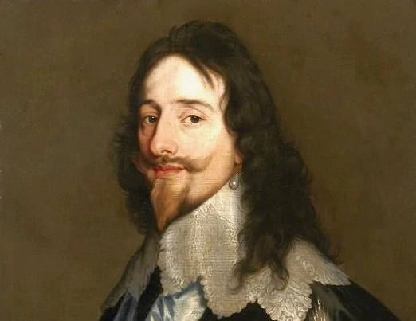
Charles I
BY MAISISE SMITH

Slide 2
CHARLES I who was he ?
Charles I was born on 19 November 1600 and sadly died on the 30 January 1649. Charles I , the second son of James VI of Scotland and Anne of Demark. When Queen Elizabeth I died James VI (his dad )ruled England and Scotland. Charles older brother henry ,whom he adored, was very popular but then died in 1612 leaving Charles I the air to the throne .
Then 12 years after that in 1625 he finally became KING OF ENGLAND

Slide 3
How did a civil war happen ?
Charles I and parliament argued over how England should be ruled . Charles did not like being bossed about by parliament because they wanted to reduce his powers and ended up closing parliament . He believed he had right to rule from god .he made a church more catholic ,then tried to get Scottish to yours the British pray book but the Scottish refused and Charles declared war . Wars are very expensine and Charles needed more money and finally crackted and re opened parliament in 1640 but thing went bad to worse parliament then demanded more power they then took control if the army . Then in 1642 created list of demands on how the king behave . Charles did like being bossted about and declared war on parliament .the civil war

Slide 4
The civil war
The king's army was called the cavaliers made from manly rich families from the north and west England. Parliament army was called the round heads and had help from London the south east businesses and the navy
The cavaliers got gradually wore down . Charles surrender in 1646 but he did not give up and had another go at fighting parliament but this time with Scotland helped then he was defeated in 1649 parliament had enough and put him on trial for treason and was be headed then the dreadful Oliver Cromwell ruled .

Slide 5
Thank you for watching
Hope you enjoyed

